Slide 1
Color detection using python
NAME- Hariom Bhatt
COURSE- BTECH(CSE)
SEMESTER- 3RD
SECTION- D1
ROLL NO. – 2218796

Slide 2
INTRODUCTION
It is a very interesting and exciting project to do. We will be working with colors and we will get to learn about many concepts throughout this project. Color detection is necessary to recognize objects, it is also used as a tool in various image editing apps and drawing apps.

Slide 3
Meaning of coloUr detection
Colour detection is the process of detecting the name of any color. Well, for humans this is an extremely easy task but for computers, it is not straight forward. Human eyes and brains work together to translate light into color. Light receptors that are present in our eyes transmit the signal to the brain. Our brain then recognizes the color. Since childhood, we have mapped certain lights with their color names. We will be using the somewhat same strategy to detect color names.

Slide 4
Steps for the project
Download and unzip the zip file
Taking an image from the user
Next, we read the CSV file with pandas
Set a mouse callback event on a window
Create the draw_function
Calculate distance to get color name
Display image on the window
Run Python File

Slide 5
Files to be used
The project folder contains 3 files:
* Color_detection.py – main source code of our project
* Colorpic.jpg – sample image for experimenting.
* Colors.csv – a file that contains our dataset.

Slide 6
PROCESS INVOLVED
The project folder contains 3 files:
Color_detection.py – main source code of our project Colorpic.jpg – sample image for experimenting.
Colors.csv – a file that contains our dataset.

Slide 7
PROCESS INVOLVED
2. Taking an image from the user
We are using argparse library to create an argument parser. We can directly give an image path from the command prompt.

Slide 8
PROCESS INVOLVED
3. Next, we read the CSV file with panda
The pandas library is very useful when we need to perform various operations on data files like CSV. pd.read_csv() reads the CSV file and loads it into the pandas Data Frame. We have assigned each column with a name for easy accessing.

Slide 9
PROCESS INVOLVED
4. Set a mouse callback event on a window
First, we created a window in which the input image will display. Then, we set a callback function which will be called when a mouse event happens.
With these lines, we named our window as ‘image’ and set a callback function which will call the draw_function() whenever a mouse event occurs.

Slide 10
PROCESS INVOLVED
5. Create the draw_function
It will calculate the rgb values of the pixel which we double click. The function parameters have the event name, (x,y) coordinates of the mouse position, etc. In the function, we check if the event is double-clicked then we calculate and set the r,g,b values along with x,y positions of the mouse.

Slide 11
PROCESS INVOLVED
6. Calculate distance to get color name
We have the r , g and b values. Now, we need another function which will return us the color name from RGB values. To get the color name, we calculate a distance(d) which tells us how close we are to color and choose the one having minimum distance.
Our distance is calculated by this formula:
d = abs(Red – ithRedColor) + (Green – ithGreenColor) + (Blue – ithBlueColor)

Slide 12
PROCESS INVOLVED
7. Display image on the window
Whenever a double click event occurs, it will update the color name and RGB values on the window.
Using the cv2.imshow() function, we draw the image on the window. When the user double clicks the window, we draw a rectangle and get the color name to draw text on the window using cv2.rectangle and cv2.putText() functions.

Slide 13
PROCESS INVOLVED
8. Run Python File
The beginner Python project is now complete, you can run the Python file from the command prompt. Make sure to give an image path using ‘-i’ argument. If the image is in another directory, then you need to give full path of the image:

Slide 14
SOURCE CODE
1.SOURCE CODE
import cv2
import numpy as np
import pandas as pd
import argparse
#Creating argument parser to take image path from command line
ap = argparse.ArgumentParser()
ap.add_argument('-i', '--image', required=True, help="Image Path")
args = vars(ap.parse_args())
img_path = args['image']
#Reading the image with opencv
img = cv2.imread(img_path)
#declaring global variables (are used later on)
clicked = False
r = g = b = xpos = ypos = 0

Slide 15
DEMONSTRATION
#Reading csv file with pandas and giving names to each column
index=["color","color_name","hex","R","G","B"]
csv = pd.read_csv('colors.csv', names=index, header=None)
#function to calculate minimum distance from all colors and get the most matching color
def getColorName(R,G,B):
minimum = 10000
for i in range(len(csv)):
d = abs(R- int(csv.loc[i,"R"])) + abs(G- int(csv.loc[i,"G"]))+ abs(B- int(csv.loc[i,"B"]))
if(d<=minimum):
minimum = d
cname = csv.loc[i,"color_name"]
return cname

Slide 16
DEMONSTRATION
#function to get x,y coordinates of mouse double click
def draw_function(event, x,y,flags,param):
if event == cv2.EVENT_LBUTTONDBLCLK:
global b,g,r,xpos,ypos, clicked
clicked = True
xpos = x
ypos = y
b,g,r = img[y,x]
b = int(b)
g = int(g)
r = int(r)
cv2.namedWindow('image')
cv2.setMouseCallback('image',draw_function)

Slide 17
DEMONSTRATION
while(1):
cv2.imshow("image",img)
if (clicked):
#cv2.rectangle(image, startpoint, endpoint, color, thickness)-1 fills entire rectangle
cv2.rectangle(img,(20,20), (750,60), (b,g,r), -1) #Creating text string to display( Color name and RGB values )
text = getColorName(r,g,b) + ' R='+ str(r) + ' G='+ str(g) + ' B='+ str(b)
#cv2.putText(img,text,start,font(0-7),fontScale,color,thickness,lineType )
cv2.putText(img, text,(50,50),2,0.8,(255,255,255),2,cv2.LINE_AA) #For very light colours we will display text in black colour
if(r+g+b>=600):
cv2.putText(img, text,(50,50),2,0.8,(0,0,0),2,cv2.LINE_AA)
clicked=False #Break the loop when user hits 'esc' key
if cv2.waitKey(20) & 0xFF ==27:
break
cv2.destroyAllWindows()

Slide 18
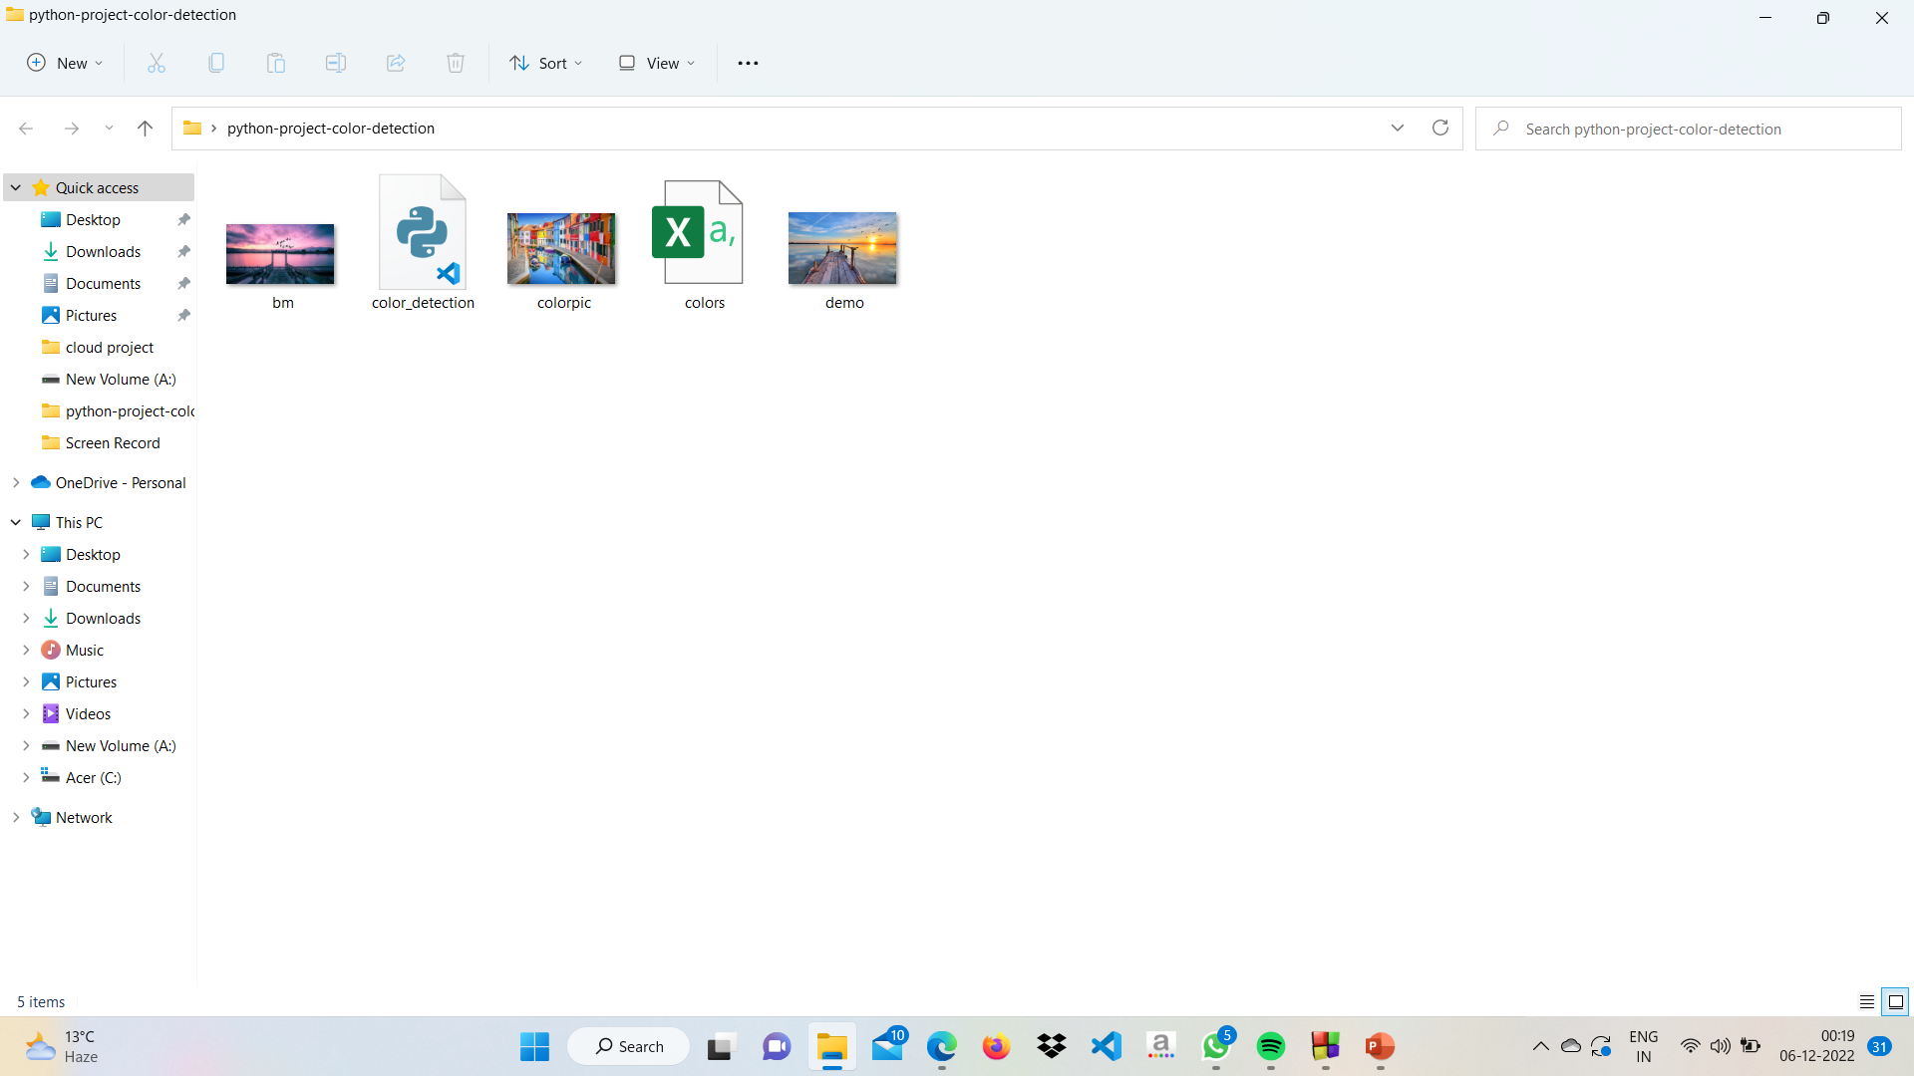
demonstration

Slide 19
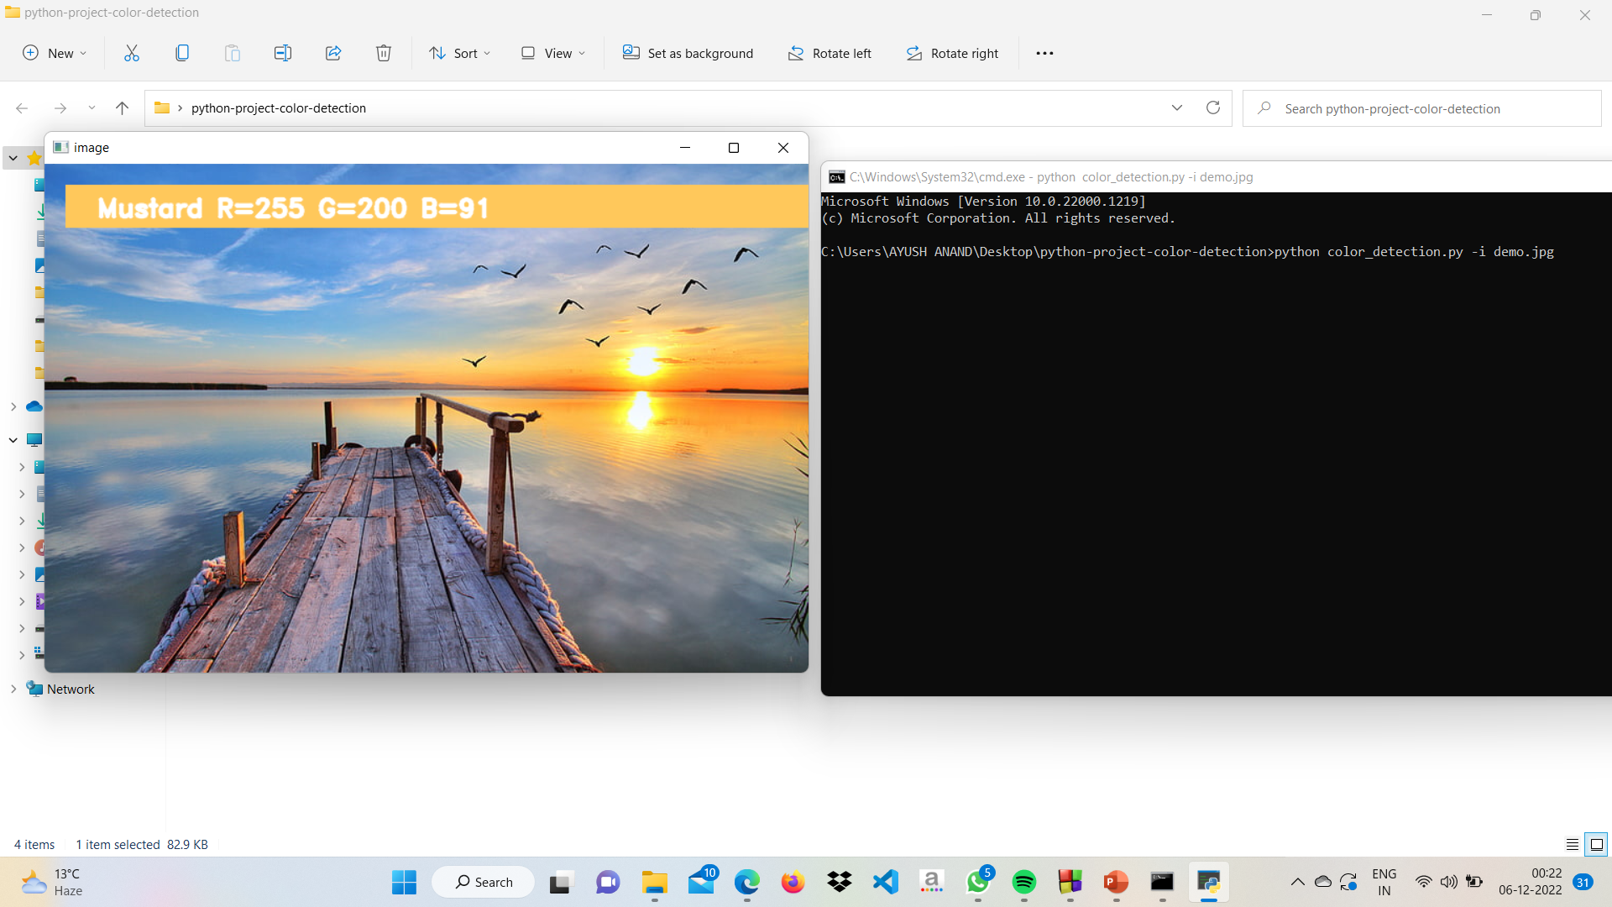
output

